Slide 1


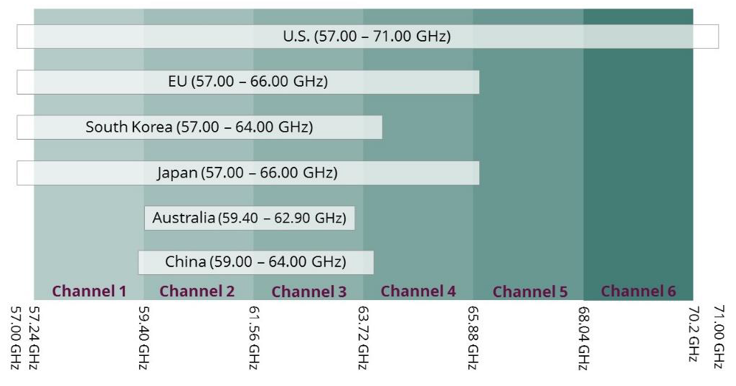
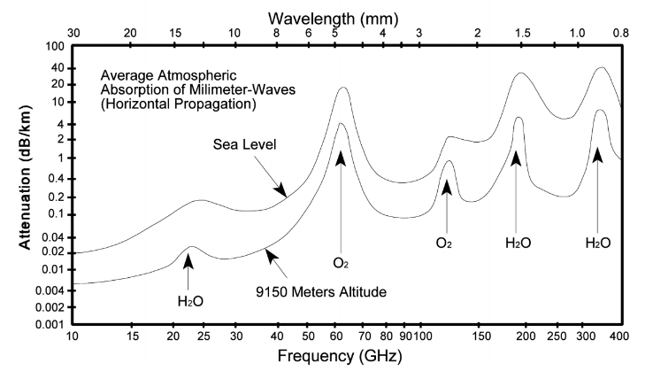
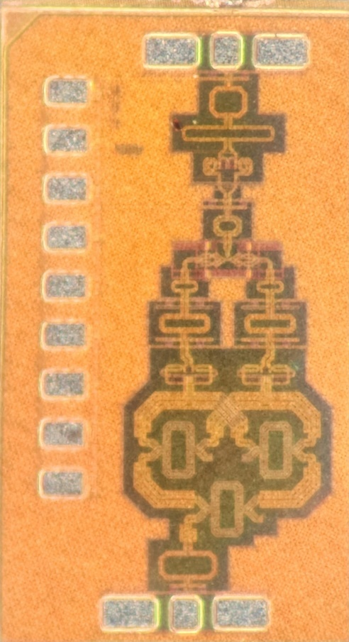
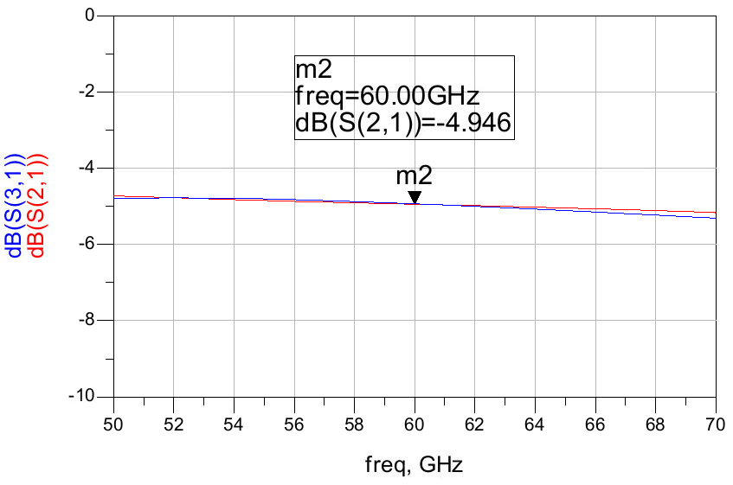
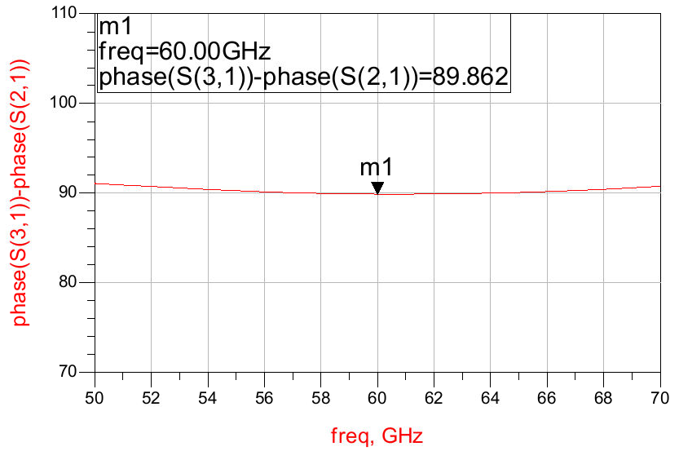
A 60-GHz Variable Gain Active Phase Shifter
With Wide Bandwidth I/Q Generator
Gyuha Lee*, Cheol So**, Insu Han*, and Songcheol Hong*
*School of Electrical Engineering, KAIST, Daejeon, Republic of Korea
**Department of Electrical and Computer Engineering, UCSB, United States
Introduction
Chip Implementation and Measured Results
Chip implementation & Measurement Setup
VNA
DC Supply
SPI Controller
Matlab
[ Frequency allocation of 60 GHz ]
[ Air attenuation by atmospheric absorption ]
[ Chip photograph ]
[ Measurement Setup ]
Unlicensed band with ultra wideband
KOR: 57~64 GHz, 7 GHz bandwidth
US: 57~71 GHz, 14 GHz bandwidth
Suitable for high data-rate communi-
cation and high resolution radar
High attenuation occurred by O₂
High path-loss at 60-GHz can be compensated by the phased array system. Also, phase shifter is the essential block of the phased array
Process: Samsung 28nm bulk CMOS
Core area: 500 x 1000 μm²
Electro-Magnetic field simulated by Keysight ADS Momentum
S-parameter of proposed phase shifter is measured by Anritsu VNA (37397D) and V-band Cascade probe tip
Vector states are controlled by Cheetah SPI Controller and Matlab
Schematic Design
2-stage hybrid-coupler-based IQ generator with wide I/Q bandwidth
2-stage hybrid-coupler-based IQ generator with wide I/Q bandwidth
[ Simulated I/Q amplitude error ]
[ Simulated I/Q phase error ]
Insertion loss: -1.9 dB (except intrinsic -3 dB)
Amplitude error < 0.05 dB @ 50 – 70 GHz
Phase error < 1 deg @ 50 – 70 GHz
60-GHz variable gain active phase shifter with wideband IQ generator
[ Block diagram of IQ generator ]
S11 < -10 dB @ 55 – 64 GHz
S22 < -10 dB @ 55 – 63 GHz
Max S21: 5 dB @ 59 GHz
3-dB Bandwidth: 56 – 64 GHz
FBW: 13.3%
P_{DC}: 17.1 mW
Hybrid-coupler-based IQ generator has wider bandwidth and lower loss compared to PPF
2-stage cascade hybrid coupler for wide IQ properties
60-GHz variable gain active phase shifter with wideband IQ generator
[ Measured S11, S22 ]
[ Measured S21 ]
[ Block Diagram of phase shifter ]
[ Schematic of vector summing amplifier]
(a)
(b)
(c)
(d)
Fig (a) – (c) are the overall gain/phase states at (a) 60 GHz, (b) 56 GHz, (c) 64 GHz.
Fig (d) is the target vector by using Look-up-table (LUT) generation method [2]. (gain 5bit, phase 6 bit, Gain tuning range 15 dB)
[2] MWCL – A 60-GHz polar vector modulator with lookup table-based calibration
[ Comparison Table ]
 | This work | TMTT 2022 | TMTT 2020 | 2016 TMTT
Technology | 28-nm CMOS | 65-nm CMOS | 65-nm CMOS | 90-nm CMOS
Topology | Active | Active | Active | Active
Freq. range (GHz) | 56 – 64 | 55-65 | 51 – 66.3 | 57 – 64
3-dB Bandwidth (GHz) | 8 | 10 | 15.3 | 7
Peak Gain (dB) | 5 | 6.2 | -1.8 | 1.1
Phase resolution (bit) | 5 | 4 | 5 | 4
Gain resolution (bit) | 7 | 3 (8 states) | N/A | N/A
RMS phase error (°) | > 0.8 | 1.17 – 2.01 | 7 | 2.3 – 7.6
RMS gain error (dB) | > 0.17 | 0.16 – 0.29 | 0.72 | 0.15 – 1.6
Gain Tuning range (dB) | 15 | 16.4 | N/A | N/A
Power Consumption (mW) | 17.1 | 25.2 | 5 | 19.8
[ Schematic of phase/gain control DACs ]
Gilbert-cell based active phase shifter structure [1]
Current steering DACs with gain control 6 bit and phase control 6 bit
Quadrant decision differential switch with control 2 bit
SPI is integrated to control DACs
Output cascode buffer is included for overall loss compensation
[1] JSSC – 0.13𝜇m CMOS phase shifters for X-,Ku-, and K-band phased arrays
Conclusions
Acknowledgement
A wideband variable gain phase shifter with wideband IQ generator is implemented and verified. To have wide IQ bandwidth and relatively low loss, 2-stage hybrid coupler is cascaded. A layout is presented to minimize overall size. The proposed circuit has 3-dB bandwidth of 8- GHz with low RMS gain/phase error, which covers overall Korean unlicensed band.
The chip fabrication and EDA tool were supported by the IC Design Education Center(IDEC), Korea.

